Slide 1


Course ID: CSE 575 Email Campaign Effectiveness Classification
Team Members:
Shreyas Hingmire
Swati Kashyap
Karan Shivareddy

Slide 2


Outline
Introduction
EDA
Data Pre-Processing
Implementing ML Models
Improving Accuracy

Slide 3
Introduction Email marketing is vital for businesses to engage directly with customers, enhancing personalized communication. It provides a cost-effective method to promote products, services, and events, yielding a high return on investment (ROI).
Problem Statement:
Companies fail to measure campaign effectiveness accurately and do not provide predictive insights for future strategies.
Many email campaigns fail to meet desired engagement levels due to various inefficiencies.

Slide 4
Goal
Objective: Develop a machine learning model to predict the effectiveness of email campaigns by classifying their outcomes into three distinct categories: Ignored, Read, and Acknowledged.
Purpose: To provide actionable insights that enable marketers to optimize campaigns, enhance engagement, and improve overall marketing strategies.
Significance
●Enhanced Decision-Making: Predictive models forecast performance, guiding strategic decisions.
●Resource Optimization: Insights ensure efficient resource allocation for optimal engagement.
●Adaptive Strategies: Anticipate outcomes to adjust marketing tactics dynamically.

Slide 5
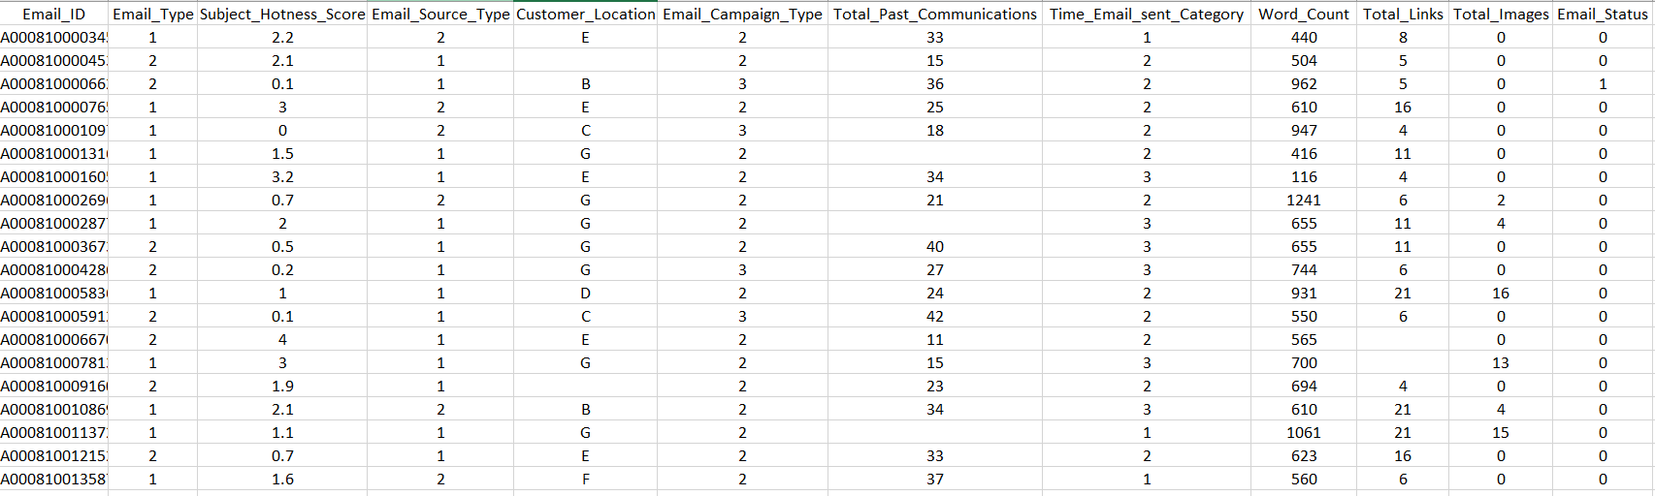
Dataset Snapshot

Slide 6
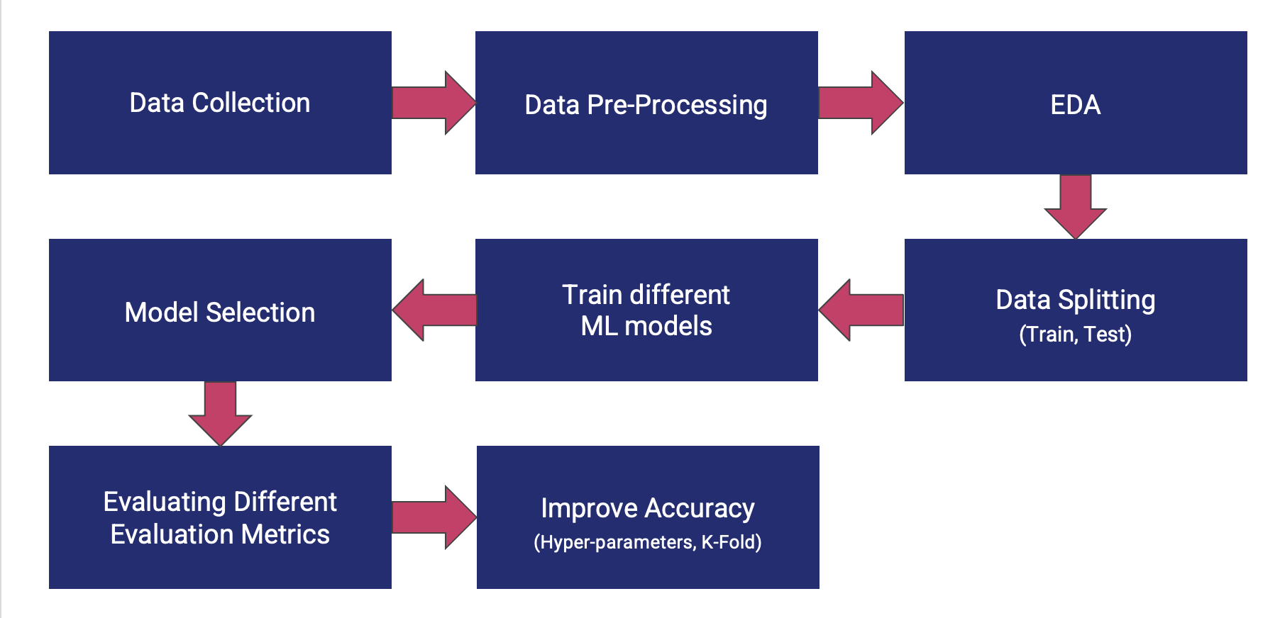
Model Pipeline

Slide 7
Data Challenges
Data can not be directly fed into the ML model.
Handling Null Values
Outliers affect data quality
Handling Multicollinearity
Some irrelevant features exist
To solve this problem, we will use Data Pre-Processing.

Slide 8
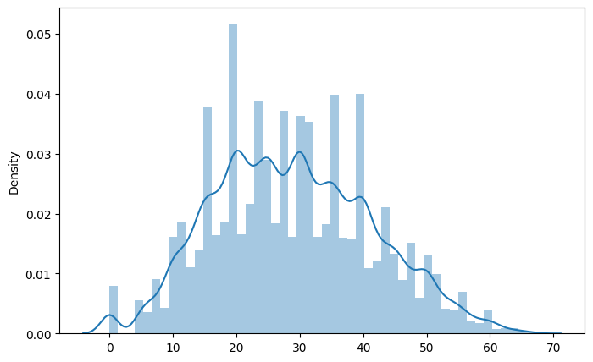
Handling Null Values
Total Past Communication
Normal Distribution, so fill in the null values with the mean.

Slide 9
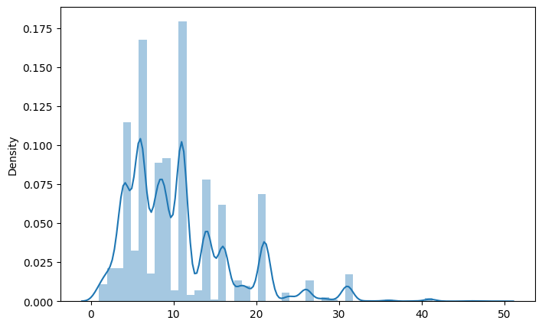
Handling Null Values
Total Links
Distribution is skewed, so fill in null values with mode.

Slide 10
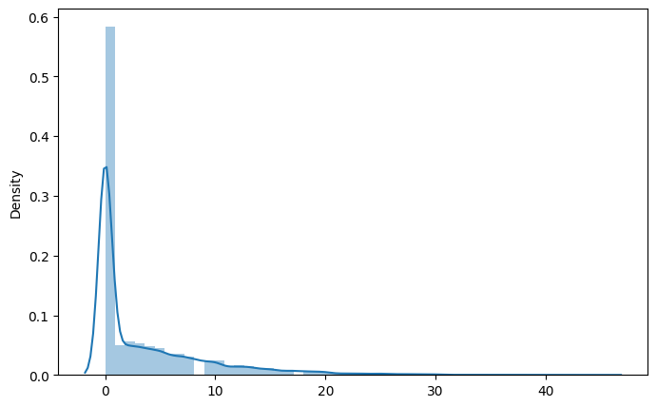
Handling Null Values
Total Images -
Distribution is skewed so fill null values with mode

Slide 11

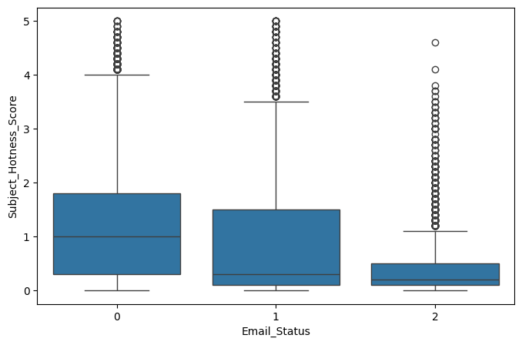
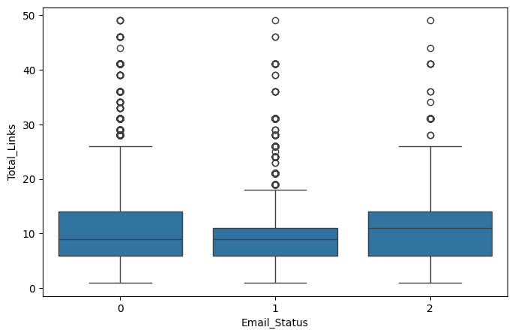
Handling Outliers

Slide 12
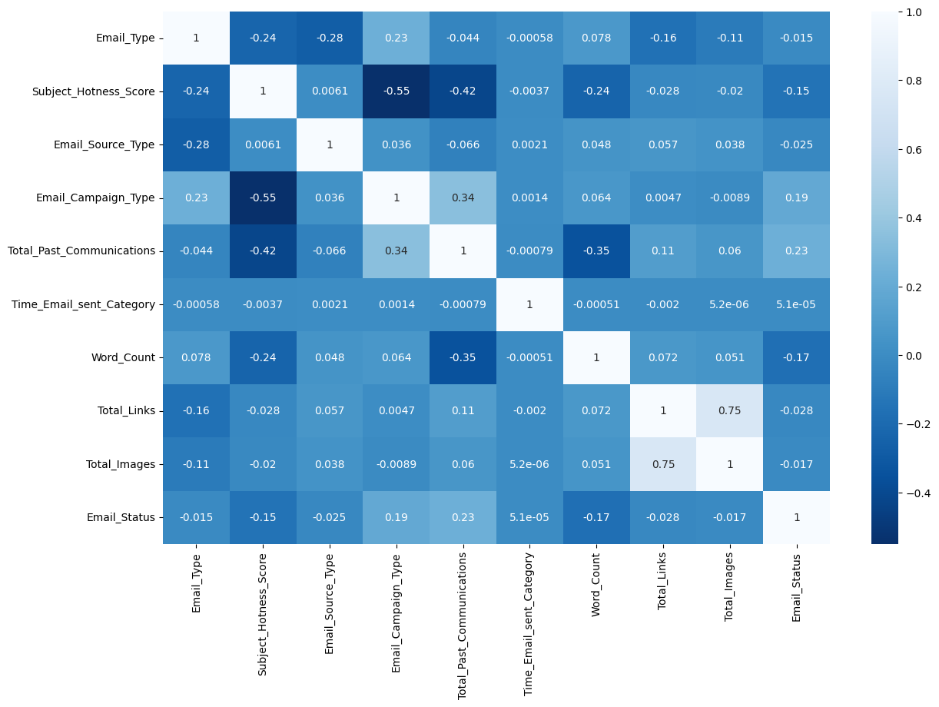

Slide 13
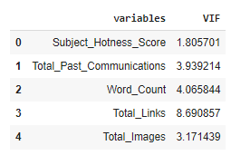
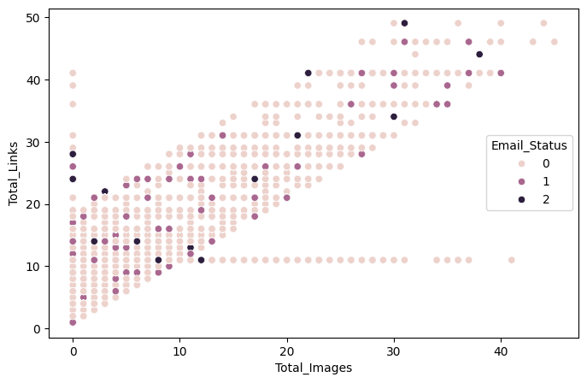
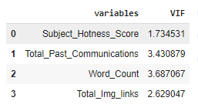
Handling Multicollinearity

Slide 14
Data Preprocessing
Handling Categorical Columns - One Hot Encoding
1
Handling Numerical Columns - Normalization
2
Removing Irrelevant Columns - Feature Engineering
3

Slide 15

Model Challenge
Finding the optimal ML model for regression
Finding the suitable number of clusters for customer segmentation
Overfitting

Slide 16
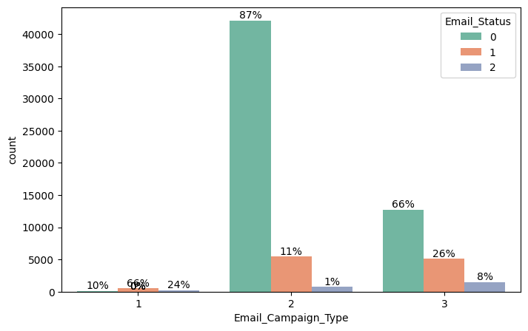
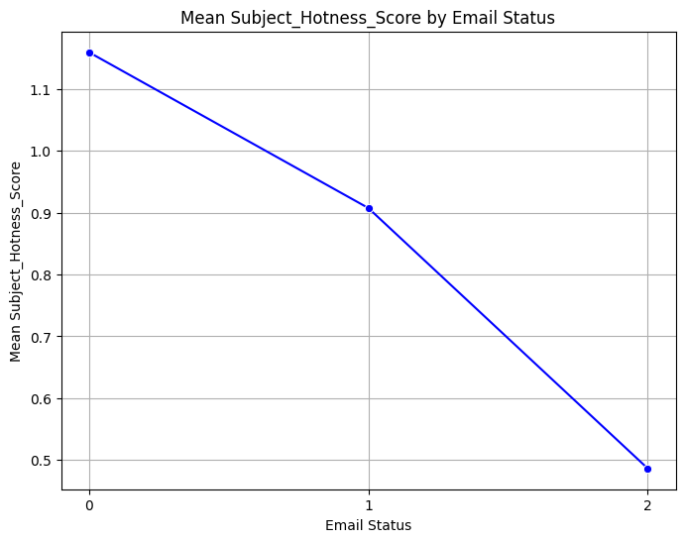
EDA

Slide 17
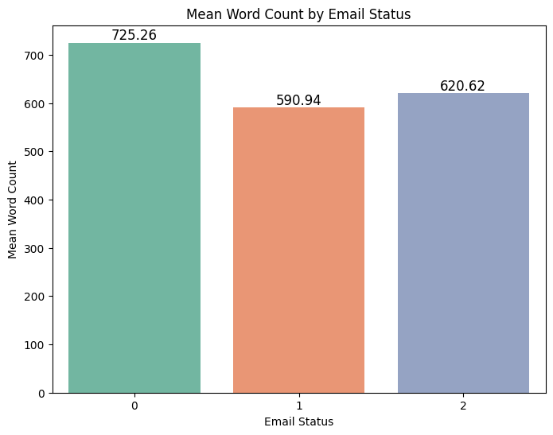
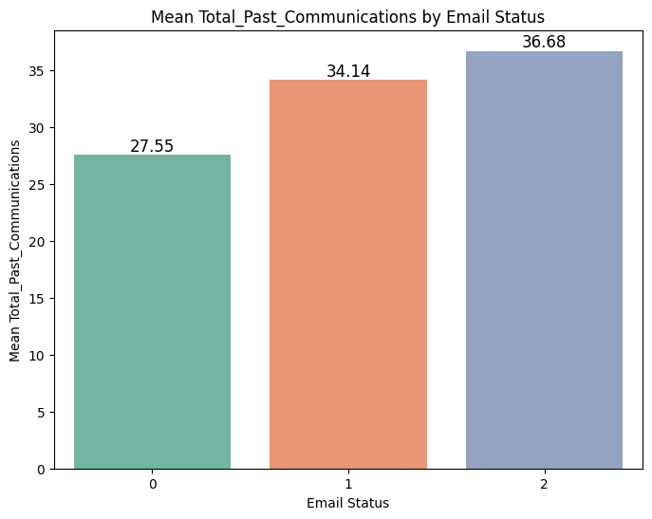
EDA

Slide 18
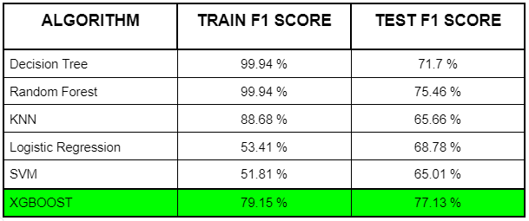
Training Different ML Models

Slide 19

XGBOOST - Improving Accuracy
Hyperparameter Tuning
Max_depth - 3 , 5, 7
Learning rate = 0.05 , 0.1 , 0.2
N_estimators = 50 , 100 , 150
subsample = 0.8 , 0.9 , 1
Colsample_bytree = 0.8 , 0.9 , 1.0
K-Fold Cross Validation

Slide 20
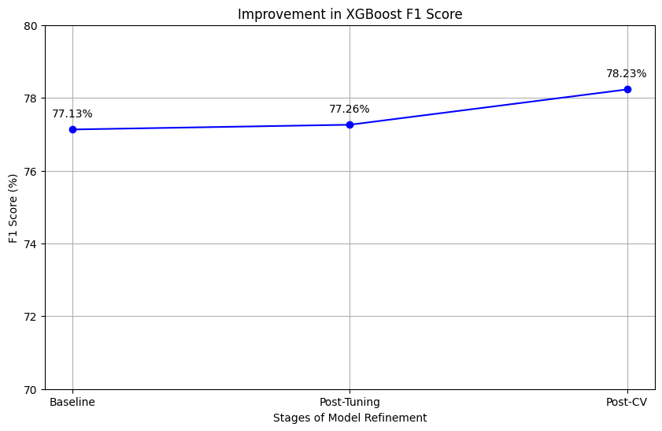

Slide 21
